Slide 1

SRM INSTITUTE OF SCIENCE AND TECHNOLOGY
COLLEGE OF ENGINEERING AND TECHNOLOGY
DEPARTMENT OF NETWORKING AND COMMUNICATIONS
18CSP109L/18CSP111L MAJOR PROJECT
SMS Spam Detection using Natural Language Processing and Ensemble Learning
Student 1 Reg No : RA1911030010100
Student 2 Reg No : RA1911030010071
Batch ID: NWC071100
Guide name and Designation : Dr. C. Fancy
Assistant Professor

Slide 2
Table of Contents
Abstract
Introduction
Motivation
Literature Survey
Challenges and limitations in existing system
Objectives of the project
Innovation Idea
Scope and application of the project
Architecture
Proposed Modules and their descriptions
Results
Future Improvements
References

Slide 3
Abstract
SMS Spam is sent by scammers trying to phish on people where they send a message to the victim saying that they have won something and want the victim to click on a malicious link to steal data or access the victim’s device. By creating multiple models for spam detection and combining the best performing models using ensemble learning techniques would give us a model which would predict a text message from spam and legitimate with much more accuracy. The model will be integrated into image steganography tool to hide message and keep it more secure in transit.

Slide 4
Introduction
Ensemble learning is a type of learning in AI/ML where multiple different models are used and then their different outputs are combined to give a final result.
By using the concept of ensemble learning, we can train multiple models and choose the ones with very high accuracy and precision and use those models together to get a model which gives a more accurate prediction.
As SMS has turned into MMS nowadays, sending images with hidden text using steganography can be used to provide another layer of security in text messages.

Slide 5
Motivation
Everyone gets annoyed when they receive spam text messages from time to time and clutter chat logs on messaging app. Sometimes people even fall for spam texts thinking they are legitimate and less educated and senior citizens are much more prone to this. By determining if a message is spam, the user can ignore and delete the message. Implementing this model in the sms application by integrating it with an image steganography tool will give an extra layer of security when in transit.

Slide 6
Literature Survey
S. No. | Journal | Name | Techniques Discussed | Conclusion
1 | Americas Conference on Information Systems (2014) | Improving Static SMS Spam Detection by using New Content-based Features | Linguistic inquiry and word count | Counts the number of common spam categorized words
2 | Proceedings of the 2006 ACM symposium on Document engineering(2012) | Content Based SMS Spam Filtering | Bayesian filters like SpamAssassin | Gives 97% accuracy
3 | Future Generation Computer Systems (2020) | Deep Learning to Filter SMS Spam | CNN models | Model gives 96% accuracy

Slide 7
Literature Survey
S. No. | Journal | Name | Techniques Discussed | Conclusion
4 | Emerging Technologies in Data Mining and Information Security(2019) | Spam Detection in SMS Based on Feature Selection Techniques | Applied Information Gain technique instead of chi square | Feature extraction gives a slight increase in accuracy
5 | Elektronika Ir Elektrotechnika(2013) | The Impact of Feature Extraction and Selection on SMS Spam Filtering | Chi square and gini index | Message length, presence of url taken in account
6 | International Conference on Soft Computing in Data Science (2016) | A Review of Feature Extraction Optimization in SMS Spam Messages Classification | Removing common occurring spam keywords, url links, monetary symbols | Gives model more parameters

Slide 8
Literature Survey
S. No. | Journal | Name | Techniques Discussed | Conclusion
7 | Procedia Computer Science (2018) | Rule-based framework for detection of smishing messages in mobile environment | Created rules such as fake url, advertising messages. | 9 Rules created by authors showed that stopwords are most efficient
8 | IEEE Access: Volume 8 (2020) | A Constant Time Complexity Spam Detection Algorithm for Boosting Throughput on Rule-Based Filtering Systems | Used hashes of words and compared to rules. | Increase in number of rules increased with time consumed
9 | International Review on Computers and Software (IRECOS) (2014) | A practical rule based technique by splitting SMS phishing from SMS spam for better accuracy in mobile device | Rules for splitting messages in two groups | Used rules focused on messages if they contain the word winner or are ads

Slide 9
Literature Survey
S. No. | Journal | Name | Techniques Discussed | Conclusion
10 | Springer Wireless Personal Communications (2019) | Detecting Streaming of Twitter Spam Using Hybrid Method | Decision trees and genetic algorithm | Combined 2 models
11 | Research Gate : Future Internet (2020) | A hybrid CNN-LSTM model for SMS spam detection in arabic and english messages | Tf-idf, cnn | Combining cnn and lstm gives a model with 96 accuracy
12 | 21st International Arab Conference on Information Technology (ACIT) (2020) | Hybrid SMS Spam Filtering System Using Machine Learning Techniques | Naïve bayes, svm, linear regression | Tuning svm with tf-idf have 100% precision

Slide 10
Challenges and Limitations
While combining the multiple models, we will need to choose the ones such that the accuracy does not decrease with keeping the precision of the model as high as possible as well. And even after creating the model, the model would still need constant training on new dataset including data generated and classified by the user themselves. Even after creating the model, it has been done so many times that attackers come up with newer phishing techniques. To prevent this, we implement an image steganography tool which can help double the security of the message while in transit.

Slide 11
Objectives of the project
The main goal of this project is to create an ensemble model with higher accuracy than its base models without losing precision of the model. Using the models that give 100% precision, we would take them as base models such that the final model can classify text messages as accurately as it can while avoiding false negatives. SMS apps can be modified such that instead of sending encrypted text messages, they send text messages hidden in images. The app would hide the text message in the image while transmitting it and will de decoded when received, even if an attacker figures it out the spam detector model will catch the message.

Slide 12
Innovation
The SMS spam detection models that have been previously created have not been created using ensemble learning techniques, i.e. current models have only been used creating Naive Bayes algorithm. By using AI model for spam detection and coupling it with image steganography to send modern sms messages so that they are harder to decrypt. Even if they are implemented in applications, they are only detecting spam and not preventing it. By creating an image steganography tool with the AI model, the text message will be hidden in an image, also providing security over the already encrypted text channel.

Slide 13
Scope and Application
The dataset will be preprocessed and features will be extracted such as number of words, letters and sentences. The words of texts will be stemmed and removing the stopwords after which the dataset will be trained on different Naive Bayes variants and the best performing model will be selected as the base models and other models including Random Forest, K nearest neighbors and more will be tested and the best performing models will be selected for the ensemble model. The model will be hosted on railways platform through streamlit library.
The application of this project is to create an interface where user can copy the text and the website hosting the model will predict if the text is spam or not.

Slide 14
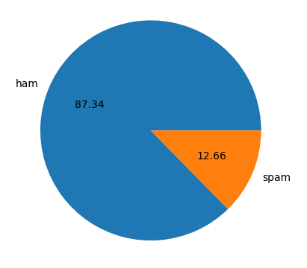
Proposed modules
The dataset was preprocessed and the dataset had 87.34% ham messages and 12.66 spam messages.Exploratory data analysis showed the common words shown in spam and ham messages and after performing feature extraction it was found that ham messages had lesser words, letters and sentences as compared to spam messages. 10 algorithms were used to train 10 models and then optimised by changing parameters and best performing models were assembled into a custom model.

Slide 15
Proposed modules
As for the security module, we created an image steganography tool that uses 1-bit least significant bit shifting method and integrated the custom ensemble model. When the sender wants to send some confidential information, they can hide it in an image and send it over the sms application, this provides a layer of security as even if an attacker tries to catch the messages, they would have to break the message encryption and then break the image encryption as well, and if they crack it and embed a spam url or spam message on an image, the model on the receiver side can decrypt the message and label it as spam and ham accordingly.

Slide 16
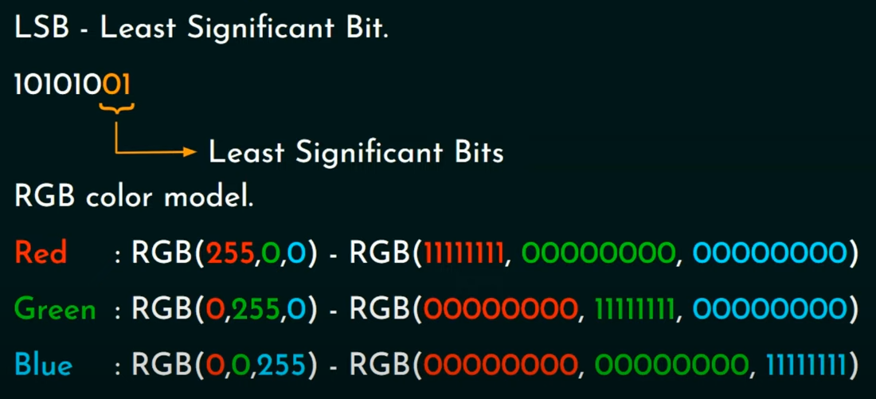
Proposed modules

Slide 17
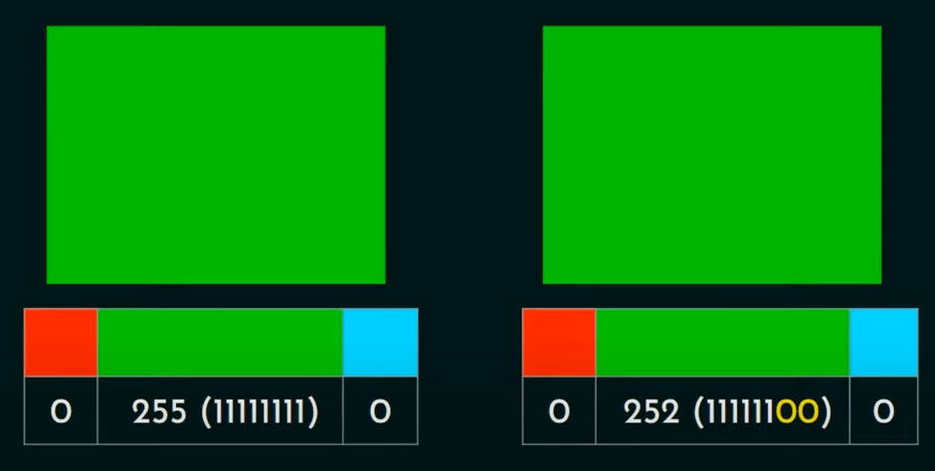
Proposed modules

Slide 18
Testing and Result Analysis
The accuracy achieved by the spam detector was 97.9% and the precision was 94.5% of the model. The implementation of the spam detection model with the Image Steganography tool was successful and the tool is able to hide images with text and while decrypting it, the spam detection model is able to predict if it is a spam message or legitimate.

Slide 19
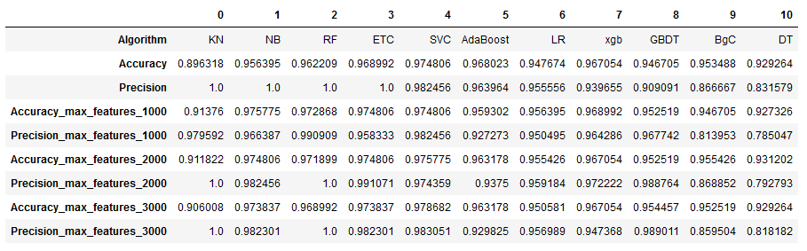
Results

Slide 20
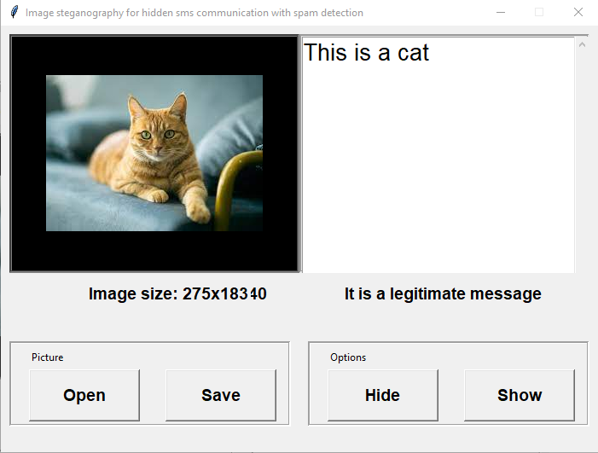
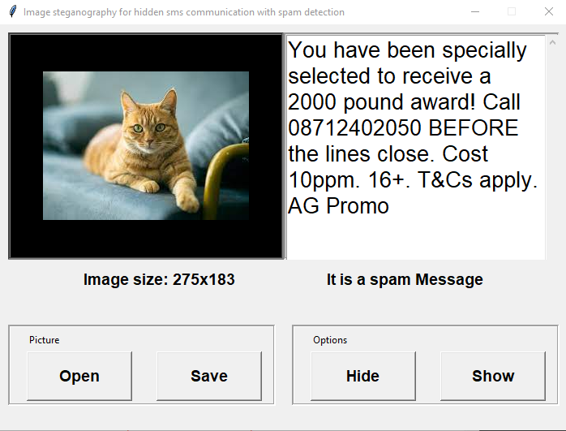
Results
Legitimate Message Spam Message

Slide 21
Future Improvements
The dataset for the AI model can be increased every time it is used by making it a live service
The tool can be implemented in SMS/MMS applications such as Google and Apple Messages in the future.
More types of Image Steganography algorithms can be implemented but can be inconsistent while decrypting

